Slide 1
CPSC 481 Artificial Intelligence
Mr. Ayush Bhardwaj
abhardwaj@fullerton.edu

Slide 2
What we will cover today
Types of environments
Search: a general purpose problem solving strategy
State spaces
Representing state spaces

Slide 3
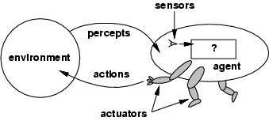
Intelligent Agents
An agent is anything that can be viewed as perceiving its environment through sensors and acting upon that environment through actuators
Human agent has eyes, ears, and other organs for sensors; hands, legs, mouth, and other body parts for actuators. Robotic agent has cameras and infrared range finders for sensors; various motors for actuators.
The agent function maps from percept histories to actions: [f: P* → A]
The agent program runs on the physical architecture to produce
agent = architecture + program
Rational agents use
performance measures
environment
actuators
sensors
Notes:
+Rational Agent: For each possible percept sequence, a rational agent should select an action that is expected to maximize its performance measure, given the evidence provided by the percept sequence and whatever built-in knowledge the agent has.

Slide 4
Properties of Task Environments
Fully observable vs. partially observable: – Fully observable if sensors detect all aspects of environment relevant to choice of action
Partially observable due to noisy, inaccurate or missing sensors
E.g., in card games, not possible to see what cards others are holding
Single agent vs. multiple agents: in single agent environment, no other “thinking” entity
Multiple agents: other entities whose goals depend on your own
Cooperative: improving other’s situation, helps your own
Competitive: improving other’s situation, worsens your own
Deterministic vs. stochastic: Deterministic if the next state of the environment is completely determined by the current state and the action executed by the agent
Stochastic if what happens is affected by randomness
E.g., roll of dice in a game
Notes:
Note: observable partially observable is different from known and unknown environment. E.g., knowing the game of rules (known) but can be still partially observable (card game). Don’t know the rules (unknown) so need to learn them.

Slide 5
Properties of Task Environments-cont.
Episodic vs. sequential: episodic if a current action will not affect future actions - the agent’s experience is divided into independent episodes. E.g., mail sorting system
Sequential if current decisions affect future decisions.
E.g., navigating a car is sequential, most games
Static vs. dynamic: Static if the environment does not change as the agent is deciding on an action. E.g., chess
dynamic if the environment may change while the agent is thinking
Discrete vs. continuous: in discrete environments, actions/percepts can take only specific values (e.g., chess); in continuous environments, there can be infinite such values.
Signals constantly coming into sensors, actions continually changing. Car driving is continuous.
Known vs. unknown: In a known environment, the outcomes for all actions are given, i.e., the rules of the game are known
If unknown, the agent will have to learn how it works.
Notes:
Note: observable partially observable is different from known and unknown environment. E.g., knowing the game of rules (known) but can be still partially observable (card game). Don’t know the rules (unknown) so need to learn them.

Slide 6
Example: playing soccer
Partially observable – Player cannot detect all the things on soccer field that can affect its action, for e.g. it cannot determine what other players are thinking.
Multi-agent – There are many players in a soccer game.
Stochastic – Given the current state and action executed by agent, the outcome cannot be exactly determined. E.g., if player kicks the ball, then the ball may or may not be stopped by other players, or the soccer field can change in many different ways depending on how players move.
Sequential – The past history of actions in the game can affect the next action in the game.
Dynamic – The environment can change while the agent is making decision, for e.g., position of other players changes when a player moves.
Continuous – Positions of the ball and players are continuous. The speed or the direction (angle) at which the player kicks the ball is continuous.
Notes:
First, who is the “agent”?
A player

Slide 7
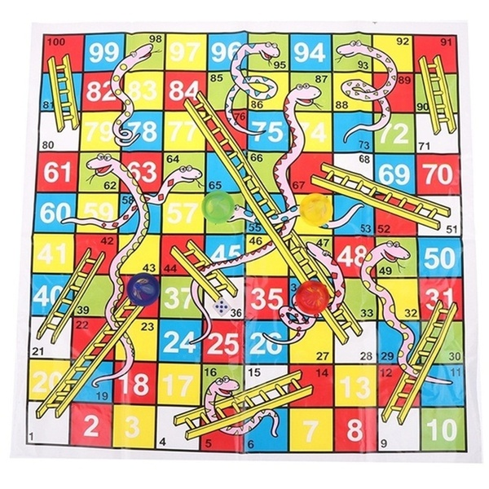
Chutes and ladders
Fully observable vs. partially observable?
Deterministic vs. stochastic?
Episodic vs. sequential?
Static vs. dynamic?
Discrete vs. continuous?
Known vs. unknown?
Single agent vs. multiple agents?

Slide 8
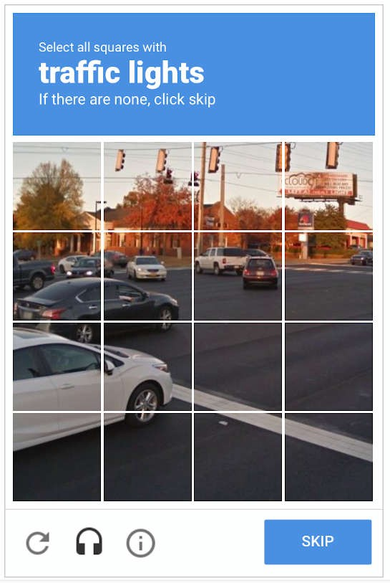
Passing a CAPTCHA
Fully observable vs. partially observable?
Deterministic vs. stochastic?
Episodic vs. sequential?
Static vs. dynamic?
Discrete vs. continuous?
Known vs. unknown?
Single agent vs. multiple agents?

Slide 9
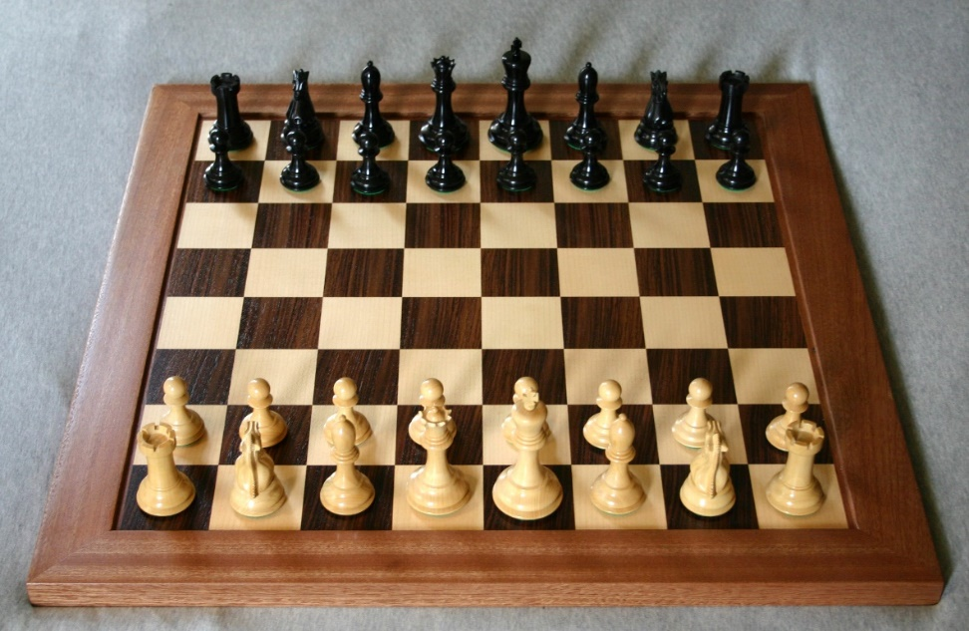
Chess
Fully observable vs. partially observable?
Deterministic vs. stochastic?
Episodic vs. sequential?
Static vs. dynamic?
Discrete vs. continuous?
Known vs. unknown?
Single agent vs. multiple agents?

Slide 10

Driving a car
Fully observable vs. partially observable?
Deterministic vs. stochastic?
Episodic vs. sequential?
Static vs. dynamic?
Discrete vs. continuous?
Known vs. unknown?
Single agent vs. multiple agents?

Slide 11
Classwork
On Google Drive
Link on Canvas
Go to today’s date and section
Editable and viewable by all
Create a new Google Document and name it with your groupmates’ names
E.g.: Garcia-Joshi-Nguyen
Write the names and role of group members
Roles: manager, recorder+presenter, timekeeper
Add your answers
Will not be graded but used for class participation points
Can easily share with rest of class outside the breakout room

Slide 12
General Problem Solving Strategy
How does a human solve a problem in general?
Do we use thousands of algorithms to solve different problems, or
use only a few general methods to solve all types of problems?
Is there a general purpose approach to solve all types of problems?
Driving a car, Playing chess, Finding the cheapest car, Buying a ticket, …
State space search as a general problem solving strategy
Notes:
Motivation: strong AI needs to have general intelligence

Slide 13
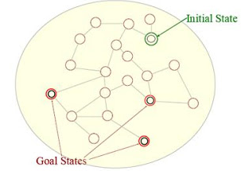
Human Problem Solving Process
Think about these problems:
Playing chess (Tic-tac-toe or 8 puzzle) game,
Navigate a maze
Driving a car
What do we do to solve a problem?
Understand the problem
solution/goal, constraints, states
Define a state for each step and find a sequence of states (or steps).
A state can be a problem solving step or status (information and available methods), e.g., a state of object in Object-Oriented programming.
Use available information and methods to move from one state to next state.

Slide 14
State Space Search
State, State Space, and Search:
A state is a representation for a problem solving step that involves available information and methods.
A state captures only the features of a problem essential to solve it
The state space of a problem: set of all possible states.
A search is an algorithm for exploring the state space.
State space search as a general problem solving strategy is based on a strategy used by humans to solve difficult problems or almost all problems if resources and time are unlimited!
AI was considered as a problem of state representation and search in early AI research.

Slide 15
State Representation
Expressiveness and efficiency are the key factors.
Need to optimize the trade-off between expressiveness and efficiency
Ultimately we need a powerful representation scheme to solve AI problems.
Different levels of state representation:
Conceptual (or mental) representation,
State
Symbolic representation,
Graph
Computer representation (data structure)
Variable, array, record, object, table, list, tree, queue, ...

Slide 16
Definition of a graph
A graph consists of
A set of nodes/vertexes/vertices
can be infinite
A set of arcs/edges that connect pairs of nodes
An arc/edge is an ordered pair, e.g., (i1, rb1) (rb1, i1)
Notes:
Notes: People often draw trees without directed arcs. It is implicit in the problem definition. In search, it is directed.

Slide 17
Terminology
End vertices (or endpoints) of an edge
Endpoints of a?
U and V
Edges incident on a vertex
Incident on V?
a, d, and b
Adjacent vertices
U and V?
U and V are adjacent
U and X?
Degree of a vertex
Degree of X?
X has degree 4
V
a
b
h
U
d
X
Z
c
e
W
g
f
Y

Slide 18
Terminology (cont.)
Path
sequence of edges
begins with a vertex
ends with a vertex
A path of length n has n edges
[U V X] is a path of length ?
Cycle
path that begins and ends with the same vertex
Examples
P₁=(V,b,h,Z) is a path
P₂=(V,b,g,f, d,V) is a cycle
V
a
b
P₁
d
U
X
Z
P₂
h
c
e
W
g
f
Y

Slide 19
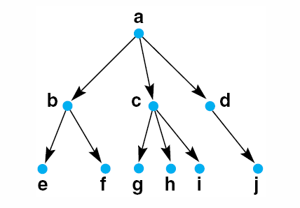
A Tree is a Rooted Graph
A tree showing a family relationships, parent and children
*Tree: has a root that has path from the root to all nodes and every path is unique without cycle.

Slide 20
Problem space
a state space: a set of states representing the possible configurations of the world
a set of operators/actions: change one state into another
The problem space is a graph where the states are the nodes and the edges represent the operators.

Slide 21
State space search
Represented by a four-tuple [N,A,S,GD], where:
N is the problem space, the set of nodes/states
A is the set of edges between nodes. These correspond to the actions/operators.
S is a nonempty subset of N. It represents the start state(s) of the problem.
GD is a nonempty subset of N. It represents the goal state(s) of the problem. The states in GD are described using either:
a measurable property of the states
a property of the path in the search (a solution path is a path from a node in S to a node in GD)

Slide 22
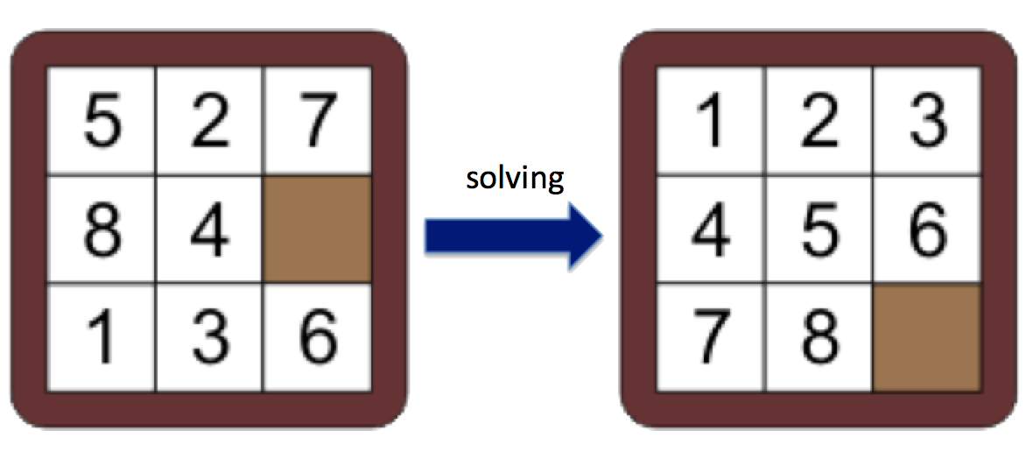
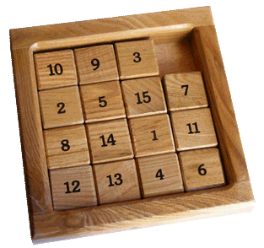
Sliding tile puzzle
solving
https://www.helpfulgames.com/subjects/brain-training/sliding-puzzle.html

Slide 23
State space of the sliding tile puzzle
State:
operators:
initial state:
goal state:

Slide 24
The 8-puzzle problem as state space search
states: possible board positions
operators: one for sliding each square in each of four directions
Better, one for moving the blank square in each of four directions
initial state: some given board position
goal state: some given board position
Note: the “solution” is not interesting here, we need the path.

Slide 25
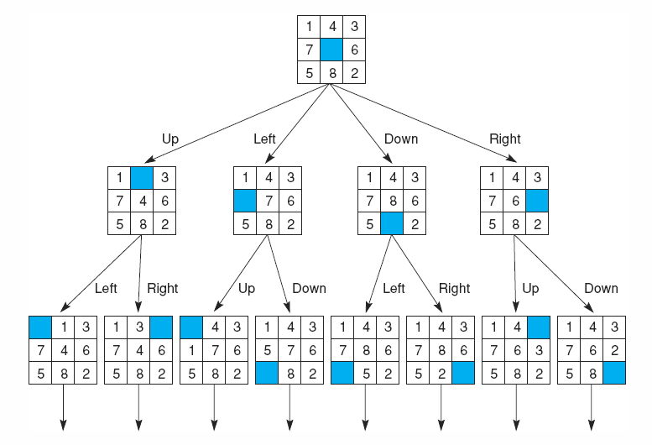
A State Space Graph for the 8-puzzle Generated by “move blank” Operations
*What are N, A, S, GD?
*What data structures can be used?
*How to search the search space?
*Search: Moving from an initial state to a goal state
Notes:
*What is GD for the 8-puzzle in previous slide? Board configuration for the goal state.

Slide 26
A graph or a tree?
Notes:
Is the “tree” for the 8-puzzle a tree or a graph?
Answer: graph because of repeated nodes

Slide 27
Classwork
Consider these two games:
Checkers/draughts
https://en.wikipedia.org/wiki/Draughts
Tic-tac-toe
What is the state?
Think about how you would represent it in a computer program
What is the state space?
What are the operators?
initial state?
goal state?

Slide 28
Classwork
On Google Drive
Link on Canvas
Go to today’s date and section
Editable and viewable by all
Create a new Google Document and name it with your groupmates’ names
E.g.: Garcia-Joshi-Nguyen
Write the names and role of group members
Roles: manager, recorder+presenter, timekeeper
Add your answers
Will not be graded but used for class participation points
Can easily share with rest of class outside the breakout room

Slide 29
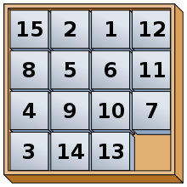
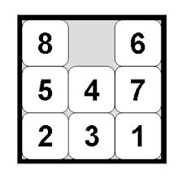
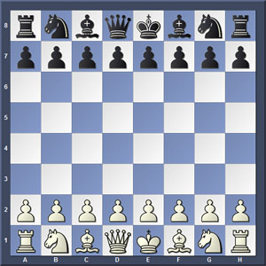
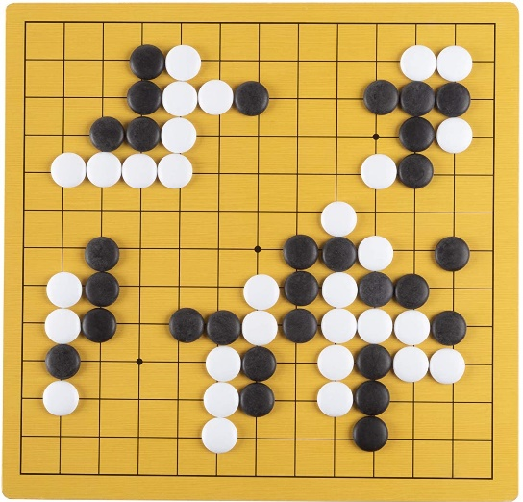
Branching factor
Number of next states from a given state
Number of children of the node
Branching factor can vary at different nodes
Average branching factor
Examples:
8-sliding tile puzzle?
15-sliding tile puzzle?
Checkers?
Chess?
Go?
Notes:
Is the “tree” for the 8-puzzle a tree or a graph?

Slide 30
Branching factor
Number of next states from a given state
Number of children of the node
Branching factor can vary at different nodes
Average branching factor
Examples:
8-sliding tile puzzle?
2-4, average=2.13
15-sliding tile puzzle?
2-4
Checkers?
About 7
Chess?
About 35, average=31
Go?
250
Notes:
Is the “tree” for the 8-puzzle a tree or a graph?

Slide 31

State space complexity
State space: set of all possible states of a problem
State space complexity: number of states in the state space
Examples:
8-sliding tile puzzle?
15-sliding tile puzzle?
Checkers?
Chess?
Go?
https://en.wikipedia.org/wiki/Game_complexity
Notes:
8-tile: 9x8x7x6x… (actually divide by 2)
15-tile: 16x15x…
Chess: 10^120
Checkers: 10^31
Go: 10^360

Slide 32
State space complexity
State space complexity: number of states in the state space
Examples:
8-sliding tile puzzle?
15-sliding tile puzzle?
Checkers?
Chess?
Go?
if branching factor is 10, then
10 nodes one level down from the current position
10² (or 100) nodes two levels down
10³ (or 1,000) nodes three levels down, …
State space explosion
Notes:
Is the “tree” for the 8-puzzle a tree or a graph?

Slide 33
Searching a graph: the challenge
Number of nodes is practically infinite
Cannot pre-compute all nodes and store it in a computer/data structure
“Search”, not a “traversal”
Nodes can reappear in the search
Possible to get into loops

Slide 34
Searching a graph (simplified)
Start with the initial state
Loop until goal found
find the nodes accessible from the root

Slide 35
References
George Fluger, Artificial Intelligence: Structures and Strategies for Complex Problem Solving, 6th edition, Addison Wesley, 2009. Chapter 3.
Russel and Norvig, Artificial Intelligence: A Modern Approach, 3rd edition, Prentice Hall, 2010. Chapter 3.3

